Slide 1

Experiment 1:
Group1: Nrf2-/-, AIN93M (N=9)
Group2: Nrf2-/-, PEITC (N=9)
Experiment 2:
Group3: WT, AIN93M (N=5)
Group4: WT, PEITC (N=5)
Experiment 3:
Group5: WT, AIN93M (N=5)
Group6: WT, AIN93M, DSS (N=5)
Group7: WT, Cranberry, DSS (N=5)
Group8: WT, PEITC, DSS (N=5)
Group9: Nrf2-/-, AIN93M (N=5)
Group10: Nrf2-/-, AIN93M, DSS (N=5)
Group11: Nrf2-/-, Cranberry, DSS (N=5)
Group12: Nrf2-/-, PEITC, DSS (N=5)
AIN93M : Groups 1, 3, 5, 6, 9 and 10
AIN93M: Groups 2, 4,
7, 8, 11 and 12
AIN93M + 0.05% PEITC Groups 2, 4,8 and 12
AIN93M + Cranberry: Groups 7 and 11
X
X
X
X
X
X
Week 0 1 2 4 5 6 8
Gut microbiota equalization period (2 weeks)
Notes:
Figure 1: Experimental design. Mice fecal samples for the 16S sequencing were collected individually at 3 timepoints – at the end of the 2-week equalization period (Week 0), at an early timepoint (Week 1) and at a late timepoint (Week 4 or Week 8). Samples used for metabolite analysis were collected at an early and a late timepoints (Weeks 2 and Week 6 respectively).
Experiment 1 (Exp01) = Nov18
Experiment 2 (Exp02) = May19
Experiment 3 (Exp03) = Sep19

Slide 2
Notes:
Supplemental Figure 1: 16S sequencing depth (total number of hits per sample).

Slide 3
A
B
Notes:
Figure 2: Alpha diversity measured by Shannon index. (A) Averages of Shannon indices calculated on raw OTU numbers and (B) on corrected OUT numbers (OTU+1).

Slide 4
A
B
Notes:
Supplemental Figure 2: Shannon index vs. sequencing depth.

Slide 5
Notes:
Supplemental Figure 3: logit of the relative abundance of Phylum vs. sequencing depth

Slide 6
Notes:
Figure 4: Biplot of logit relative abundance of Phylum

Slide 7
Notes:
Figure 5: biplot of logit relative abundance of Phylum in Exp03 only

Slide 8
Notes:
Figure 6: Biplot of logit relative abundance of Classes

Slide 9
Notes:
Figure 7: biplot of logit relative abundance of Classes in Exp03 only

Slide 10
Notes:
Figure 8: Means of log2 F/B ratios by genotype and diet over time. The bars represent standard errors of log2(F/B) ratios.

Slide 11
Notes:
Figure 9: Linear discriminant analysis Effect Size (LEfSe) analysis of aging effect.

Slide 12
Notes:
Figure 10: Linear discriminant analysis Effect Size (LEfSe) analysis of diet effect.

Slide 13
A
B
Notes:
Figure 11: Biplots of amino acids by diet (A) and bile acids by genotype (B) .

Slide 14
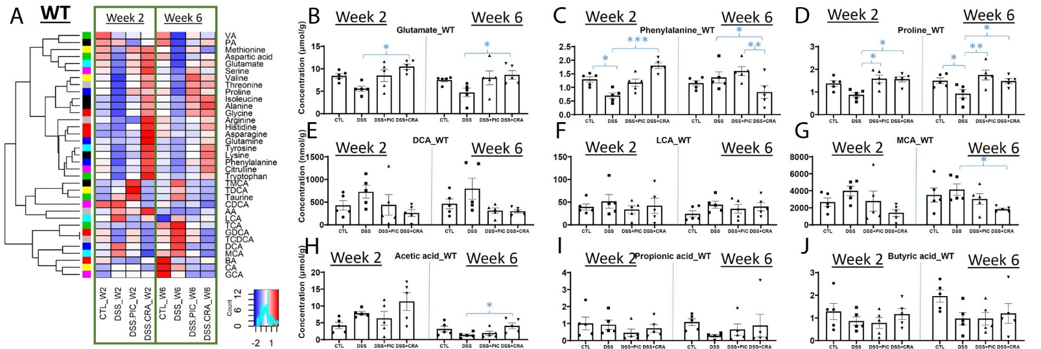
Notes:
Figure 12: Effects of DSS, PEITC and cranberry cotreatments on fecal metabolome of WT mice. Fecal samples collected at week 2 and 6 of 4 treatments, including control (CTL), DSS, DSS+PEITC (DSS+PIC), and DSS+cranberry (DSS+CRA), were analyzed by 4 LC-MS methods (143). The concentrations of amino acids, bile acids, and SCFA were quantified. (A) A heatmap on the distribution of amino acids, bile acids and SCFA in fecal samples from 4 treatments. (B-D) Concentrations of major amino acids, including glutamate, phenylalanine, and proline. (E-G) Concentrations of major bile acids, including DCA, LCA, and MCA. (H-J) Concentrations of major SCFA, including acetic acid (AA), propionic acid (PA), and butyric acid (BA).

Slide 15
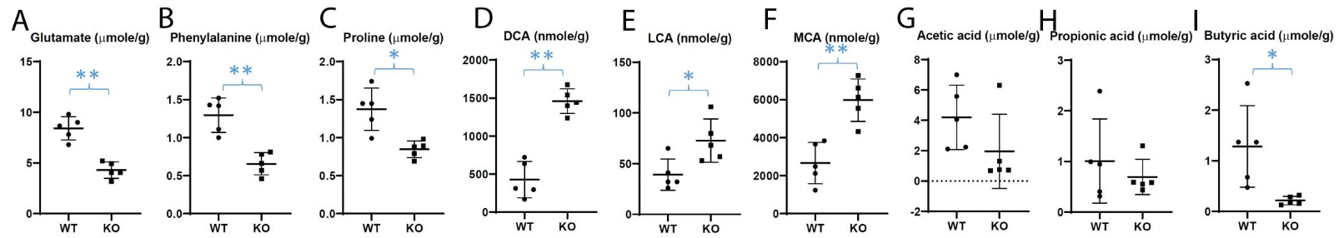
Notes:
Figure 13: Differences in fecal metabolite profile between WT and Nrf2-null (KO) mice. The concentrations of amino acids, bile acids, and SCFA were quantified in the fecal samples from untreated WT and KO mice (143). (A-C) Concentrations of glutamate, phenylalanine, and proline. (D-F) Concentrations of major bile acids. (G-I) Concentrations of major SCFA.

Slide 16
Forward Primer | Reverse Primer
515F (Parada) | 806R (Apprill)
GTGYCAGCMGCCGCGGTAA | GGACTACNVGGGTWTCTAAT
Notes:
Supplemental Table 1: V4 primer sequence used for 16s RNA sequencing library preparation

Slide 17
Kingdom | Experiment 1: Nrf2 KO Mice | Experiment 2: WT Mice | Experiment 3: WT and Nrf2 KO | Combined
Bacteria | 10,197 (94.78%) | 7,994 (98.34%) | 7,558 (96.07%) | 22,251 (95.73%)
Eukaryota | 472 (4.39%) | 116 (1.43%) | 232 (2.95%) | 812 (3.49%)
Archaea | 4 (0.04%) | 0 (0%) | 2 (0.03%) | 6 (0.03%)
Unknown | 86 (0.80%) | 19 (0.23%) | 75 (0.95%) | 175 (0.75%)
Notes:
Table 1: OTUs mapping to Kingdoms. Number of OTU (% total)

Slide 18
Notes:
Table 2: multinomial regression predictions of treatment groups by microbial metabolite PCA

Slide 19
Notes:
Table 3: multinomial regression predictions of genotype by microbial metabolite PCA

Slide 20
EXTRA: NOT NEEDED FOR THE PAPER

Slide 21
C
Biplots of bacterial metabolites. The points represent individual samples are color-coded by treatment and diet or by genotype. The arrows show the direction of the increased amount and relative magnitude of the effect of each microbial metabolite. (a) Biplot of amino acids color-coded by treatment and diet; (b) biplot of bile acids color-coded by genotype; (c) biplot of SFA color-coded by treatment; (b) biplot of SFA color-coded by genotype.

Slide 22
Biplots of bacterial metabolites. The points represent individual samples are color-coded by treatment and diet (a) or by genotype (b). The arrows show the direction of the increased amount and relative magnitude of the effect of each microbial metabolite and color-coded by the type of metabolite.

Slide 23
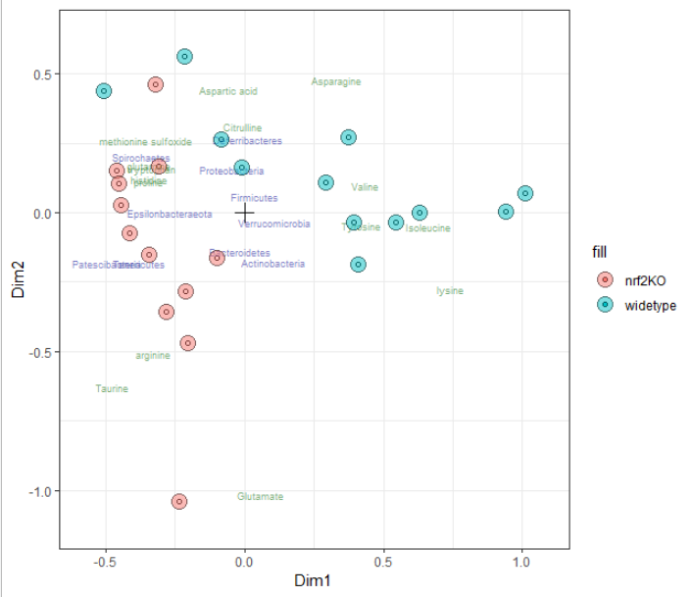
COMBI data integration – microbial counts + aminoacids

Slide 24
Renyi’s comments, 03/27/21
Cranberry diet was not included in the Results section, but it's in the title and included in the figures. Need to include or exclude cranberry for all parts. DONE
The figure labelling is not consistent. timepoint Week_4 in Fig 1 but week_8 in Fig. 4. and labels such Con_PEI_18, con_PEI_19 , are confusing ( I know 18 and 19 refer to the year the experiments were performed, but not relevant here)
The circle figures (Fig 5-7) are hard to understand for average readers.
The 16s sequencing data, raw and analyzed, may need to be uploaded to NCBI GEO.

Slide 25
Submission to Molecular Nutrition and Food Research (No Longer Applicable!)
Abstract: 200 words (currently 270)
Total: 5,000 words, 7 pages max (free) including references as well as figure and table legends
Figures: TIFF, 800-1,200 DPI (how many?)
Figure legends: separate Word file
Davit’s notes:
Proposing to remove COMBI and make another paper with machine learning and COMBI algorithms, Sep19 data only as it has both, 16S and metabolites.

